Slide 1




Six Virtual Developer Meetups
Wednesday July 8th – Cloud Operations
http://bit.ly/real-oci
Cloud Native Application Development on Oracle Cloud Platform
Recordings are on YouTube: bit.ly/real-utube
Rolando Carrasco
Lucas Jellema
Monitoring | Vault | Infrastructure as Code | Terraform | Resource Manager | Logging

Slide 2
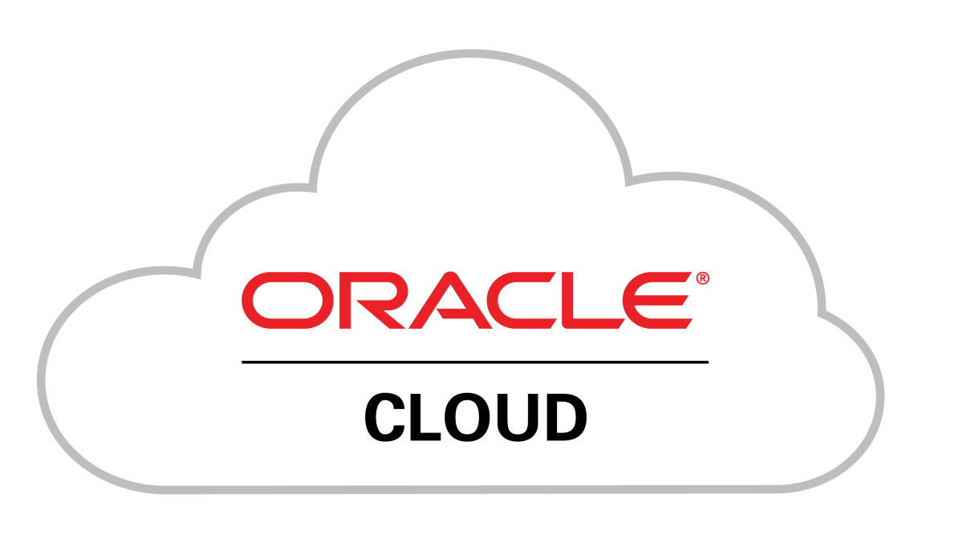

See
Hear
Native Application Development
Do

Slide 3
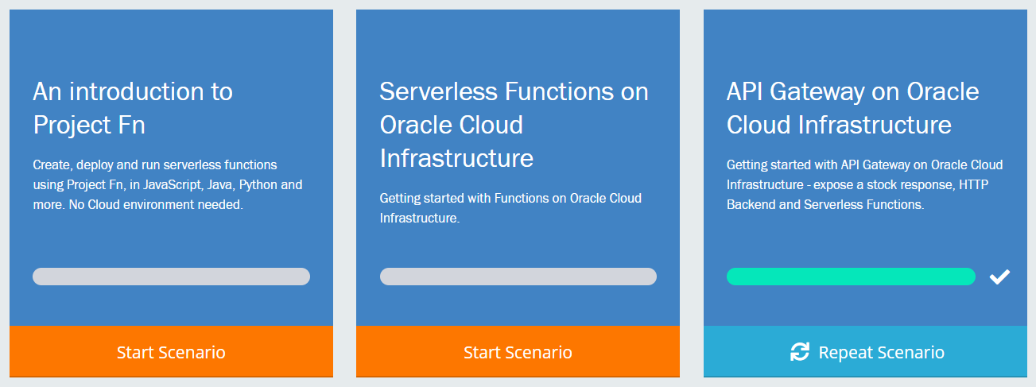

Touring Oracle Cloud services for cloud native application development
Introduction
Demonstration
Guided Handson Labs
Q&A
All sessions are recorded and will be available for replay

Slide 4

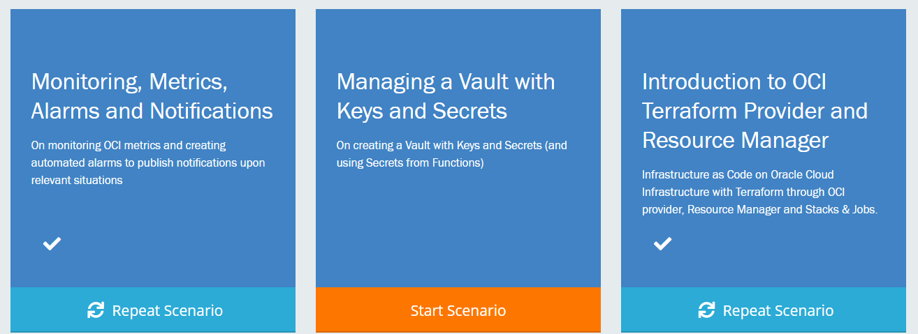
http://bit.ly/real-oci

Slide 5
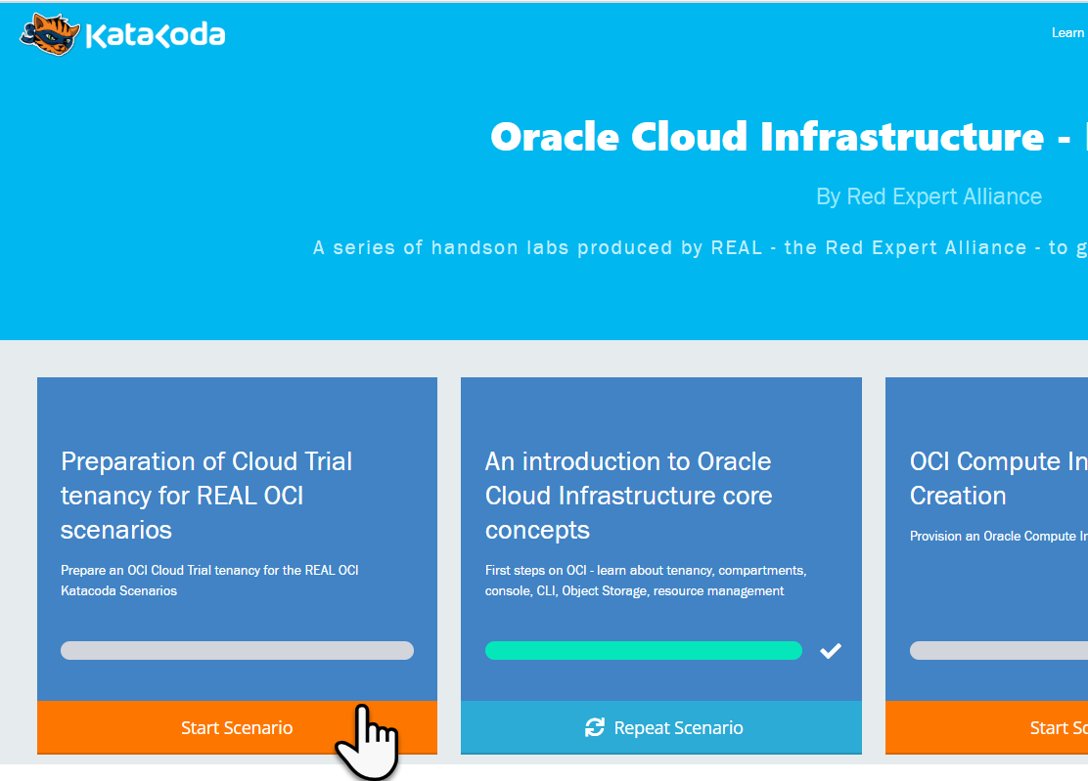
Preparation for the Katacoda Hands-On Labs
Arrange access to Oracle Cloud Infrastructure Tenancy
Existing or new OCI Cloud Trial
Existing OCI tenancy
Go to http://bit.ly/real-oci home of the REAL Katacoda scenarios for OCI
Run First Scenario to prepare the OCI tenancy for REAL Katacoda OCI Scenarios
Provision an OCI compartment and some resources
Prepare auth token, key pair and config file for using the OCI CLI in other scenarios
Go http://bit.ly/real-oci

Slide 6

Cloud Trial as Registered Webinar Attendee
cloud.oracle.com/tryit
Signup for Cloud Trial with same email address as used for webinar registration
Use a company email address (not gmail or hotmail); do not use an address already used for an Oracle Cloud Trial
Do not use credit card – because email is whitelisted (as of tomorrow, June 11th)
You will get
$500 credits on (discounted) Oacle cloud services
Access to always Free Tier

Slide 7
The Prepared Tenancy
Security
Group
VCN
vcn-lab
Tag Namespace
lab-tags
IGW
Public Subnet-vcn-lab
Private Subnet-vcn-lab
policies
API Gateway
lab-apigw
Dynamic Group
lab-apigw-dynamic-group
Stream
lab-stream
Compartment – lab-compartment

Slide 8





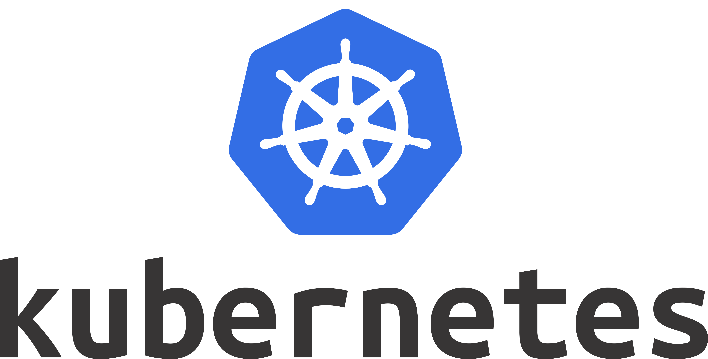

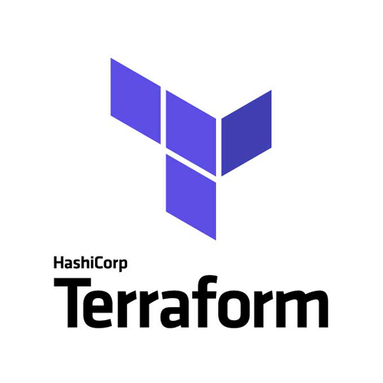



Health Check
Monitoring
Logging
Alarms
Notifi-cations
Healthcheck
Telemetry/ Monitoring
Logging
Alarming
Notifications
API Gateway
Functions
Streaming
OKE – Managed Kubernetes
Container
Streaming
Digital Assistant
Container
NoSQL Database
OCIR
Object Storage
Compute
Object Storage
ID & Access
Management
Vault
Tagging
Compartments
API/Service
Events
Resource
Manager
Search

Slide 9
Health Check
Monitoring
Logging
Alarms
Notifi-cations
Telemetry/ Monitoring
Alarming
Notifications
Healthcheck
Logging
Functions
API Gateway
Streaming
OKE – Managed Kubernetes
Container
Streaming
Digital Assistant
Container
NoSQL Database
OCIR
Object Storage
Compute
Object Storage
ID & Access
Management
Vault
Tagging
Compartments
API/Service
Resource
Manager
Events
Search

Slide 10



Focus on
Monitoring
Healthcheck
Metrics Collection, Reporting and Exploring
Alarms (& Notifications)
Logging
Audit
Vault – Management of Keys and Secrets
OCI SDK for TypeScript/JavaScript/Node
Infrastructure as Code
OCI Terraform Provider
Resource Manager
Healthcheck
Telemetry/ Monitoring
Alarming
Notifications
Logging
Vault
Resource
Manager

Slide 11
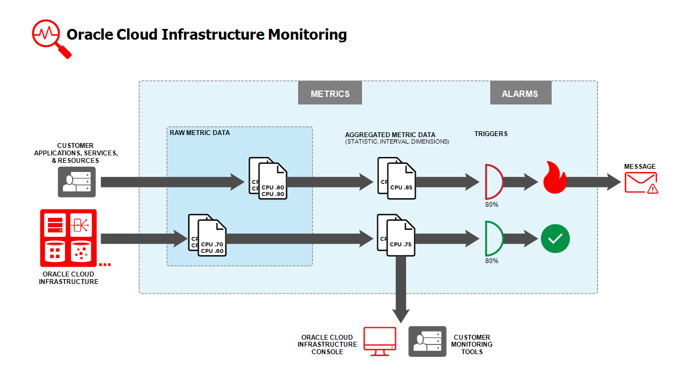

Slide 12
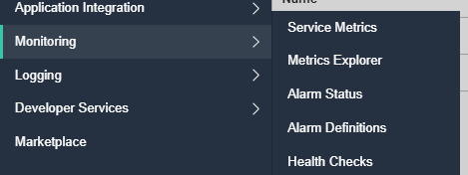

Slide 14
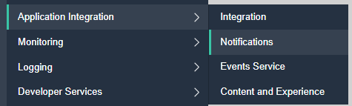
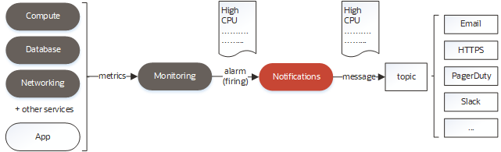
Monitoring
Aggregated Metrics
Analyze number and performance of actions
Alarms
Trigger notification when condition is observed
Notifications
Send email or call WebHook, Slack, PagerDuty or Function
Triggered by Alarm or by direct API call

Slide 15
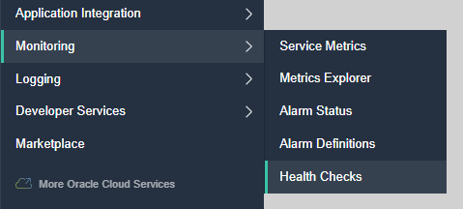


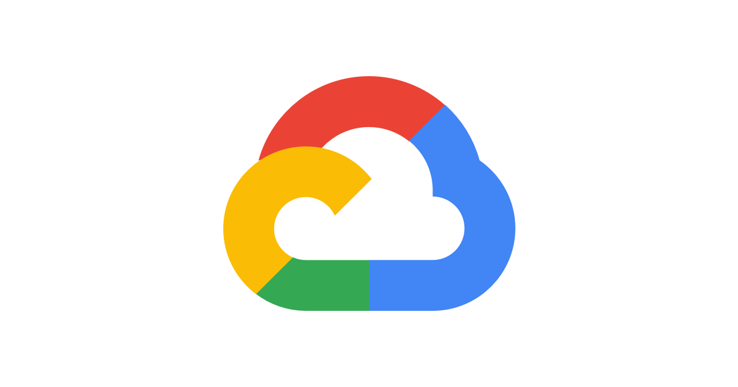


Monitoring – Health Checks
Verify through the eyes of an external client if endpoints are available and respond quick and well
Periodic or Adhoc call to an endpoint
HTTP(S) or Ping
Specify Headers
Specify Interval (30 secs minimum)
From selected Vantage Points
3rd party clouds, geographic location
Health Check results can be inspected through Service Explorer and analyzed by Alarms

Slide 16
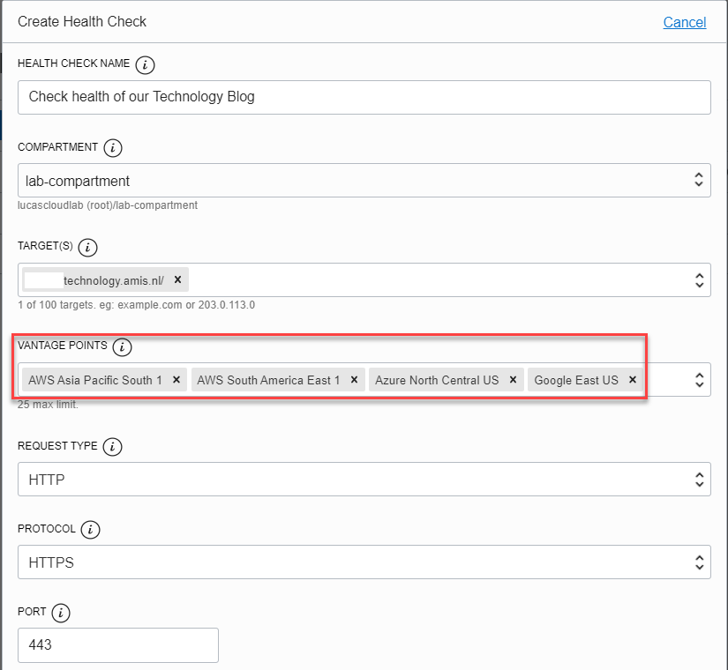
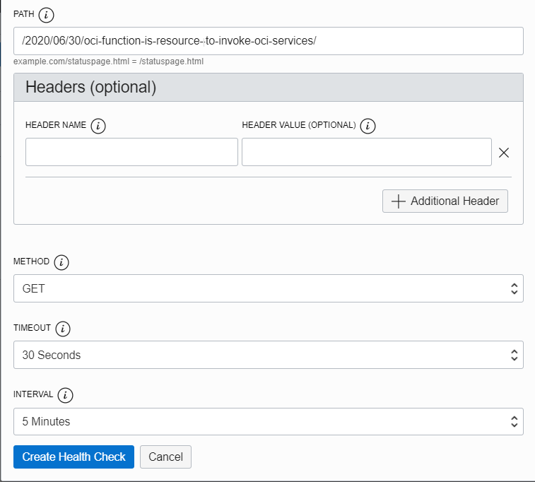

Slide 17
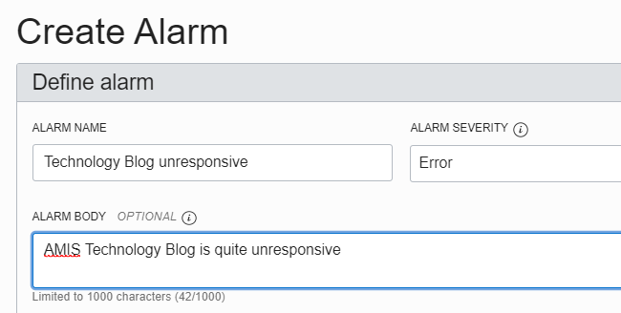
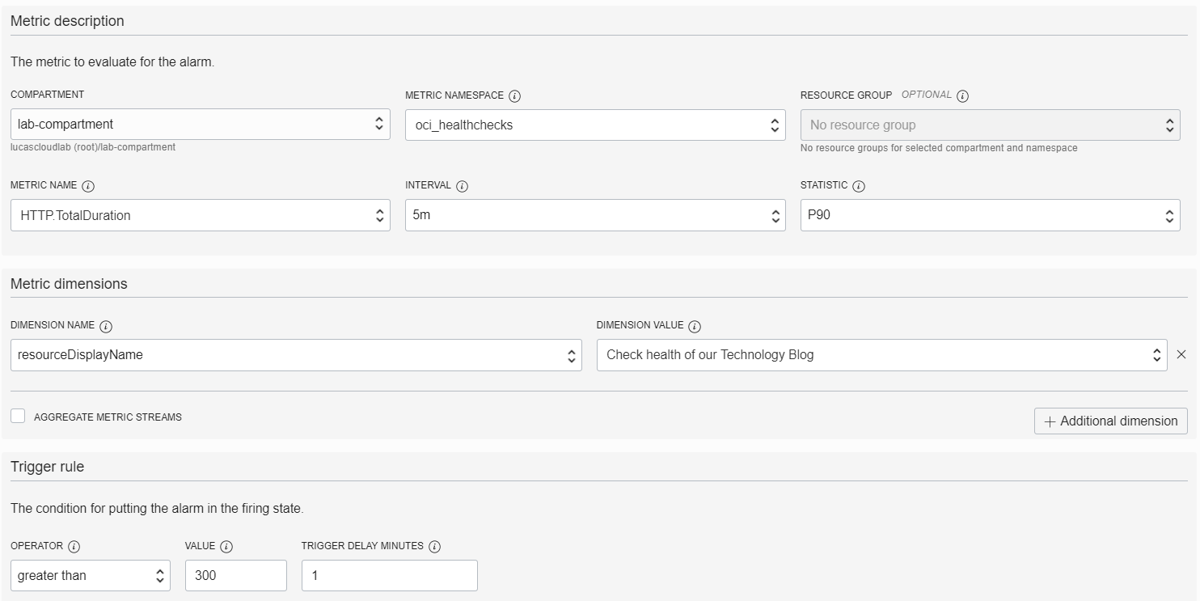
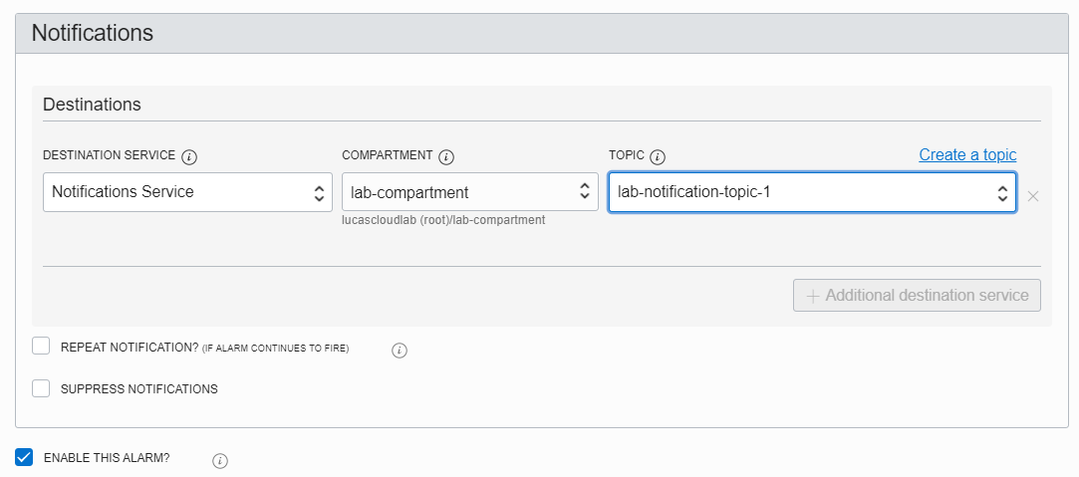

Slide 18
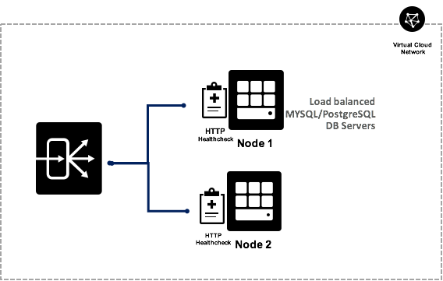
Healthcheck on “healthprobe” script that tries to connect to Database when HTTP invoked

Slide 19

Monitoring – Health Checks – as crude function scheduler
OCI does not currently have a way to schedule jobs
Health Checks are scheduled HTTP(S) requests
Available intervals: 30 secs, 1, 5, 10 and 15 minutes
OCI Monitoring Healthcheck
Check Hello
API deployment
/hello
Function
hello
API Gateway
/fn
Oracle Cloud Infrastructure

Slide 20

Health Checks on (hot) Functions
Health Checks can regularly check on Functions
And in doing so keep them ‘hot’
5 min
OCI Monitoring Healthcheck
Check Hello1
Function
hello1
API Gateway
/hello1
/hello2
15 min
OCI Monitoring Healthcheck
Check Hello2
Function
hello2

Slide 21
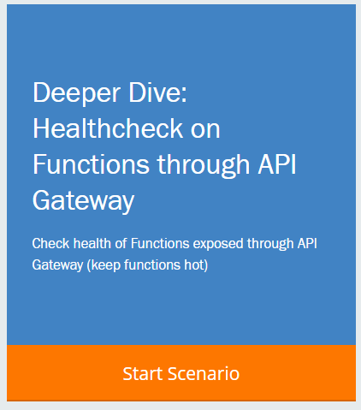


Scenario: Alarms on Health Checks on Functions
Alarm on HTTP.TotalDuration
metrics
Notification Topic
5 min
OCI Monitoring Healthcheck
Check Hello1
Function
hello1
API Gateway
/hello1
/hello2
15 min
OCI Monitoring Healthcheck
Check Hello2
Function
hello2
metrics
Alarm on HTTP.TotalDuration

Slide 22
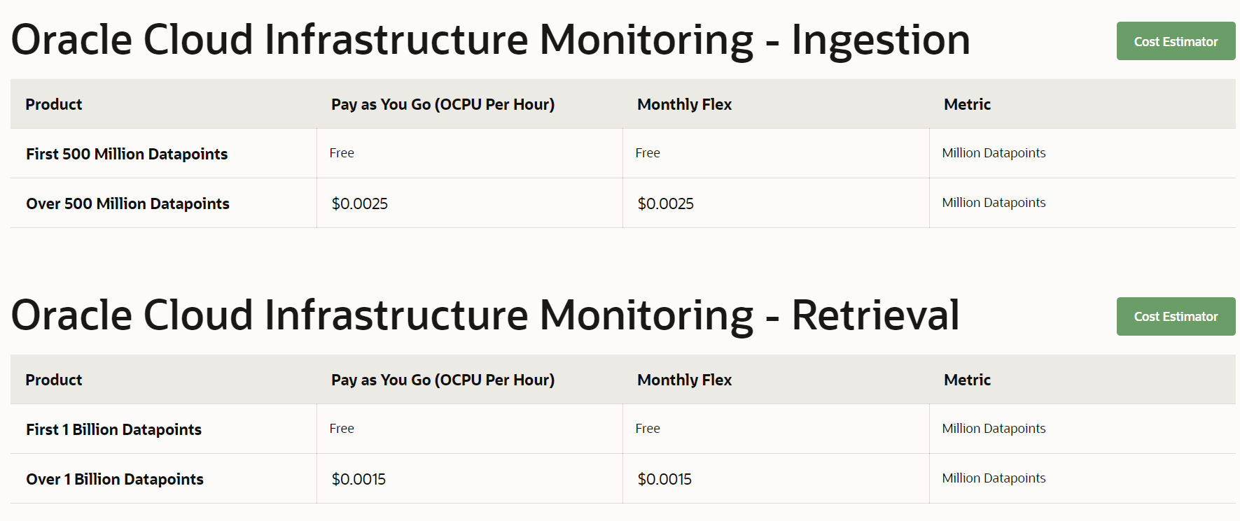
OCI Monitoring - Pricing

Slide 23
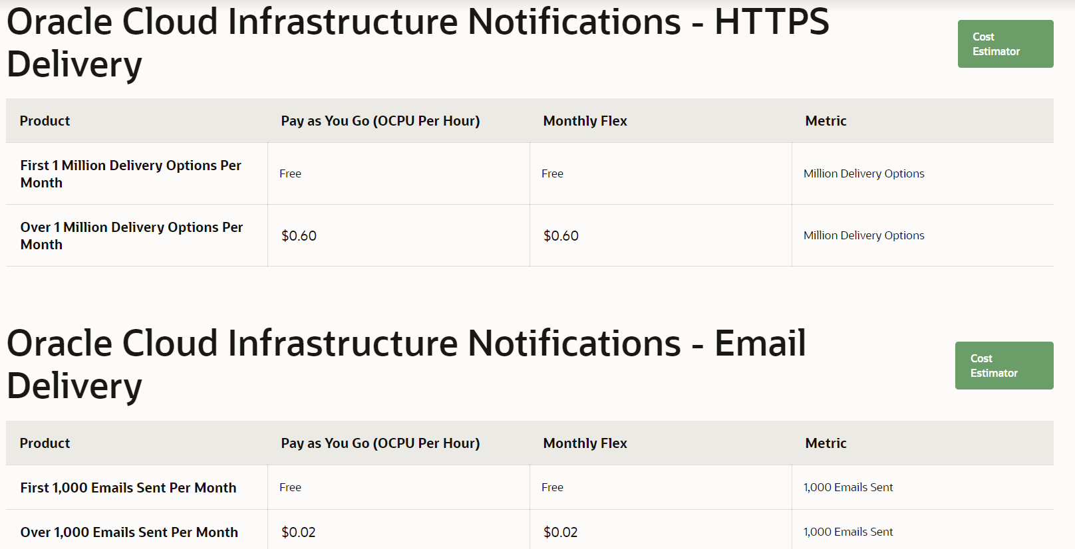
OCI Notifications - Pricing

Slide 24
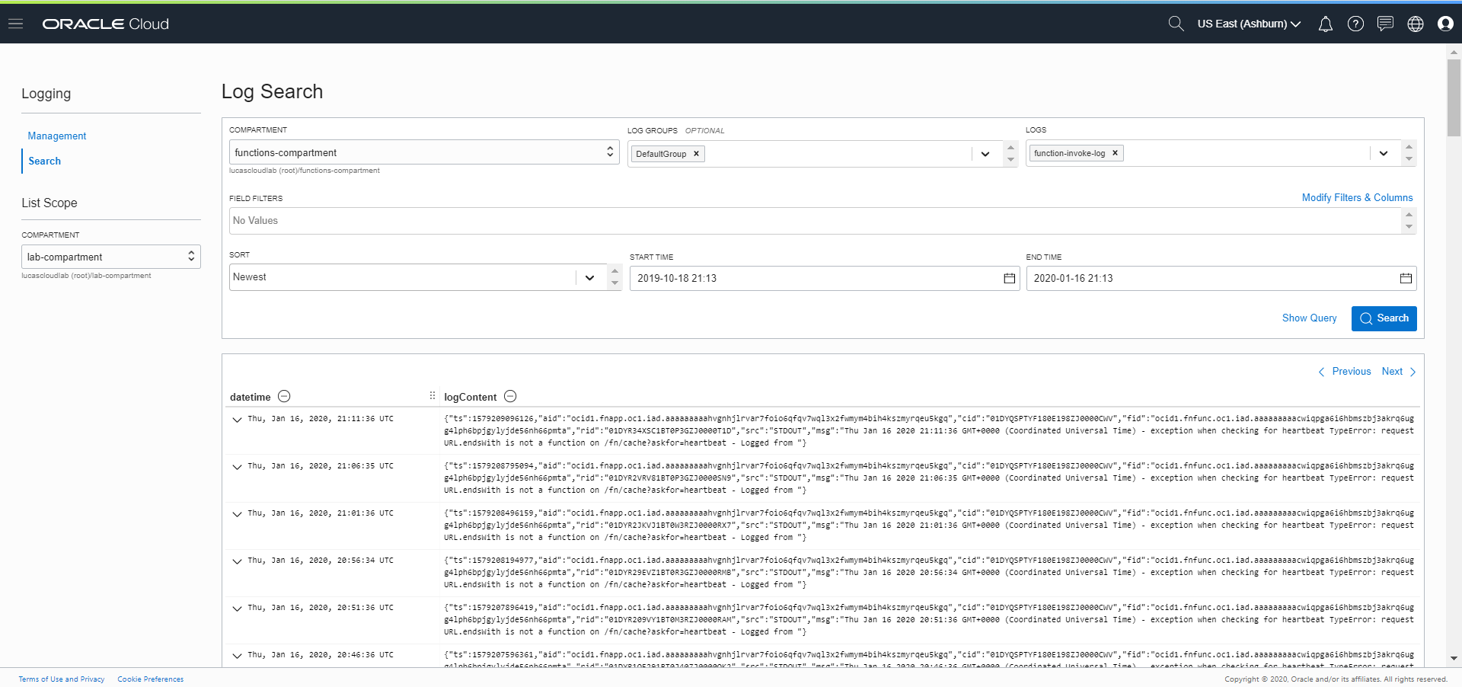
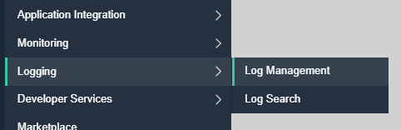
Logging
Currently in Preview
All OCI Log Files are collected and retained
At least 90 days
Log Files can be combined and searched
Similar to Elastic Search

Slide 26
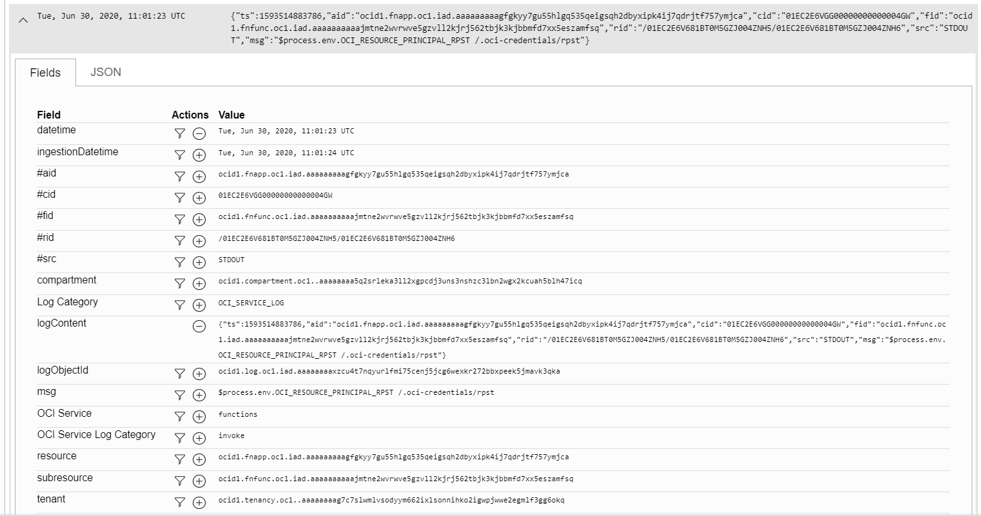

Slide 27


Audit
All OCI REST API calls are recorded in audit logs
Each action on an OCI resource is described by an Audit Event (which is a CNCF Cloud Event):
What
On Which Resource and in which OCI context
Through which service
When
Who
Request
Result
Audit Logs can be explored
A bulk export of audit details can be requested from Oracle
Retention time (default) 90 days
Can be extended up to 365 days
Note: Audit logs of OCI API calls can be used as a developer tool of if and what calls were made

Slide 28
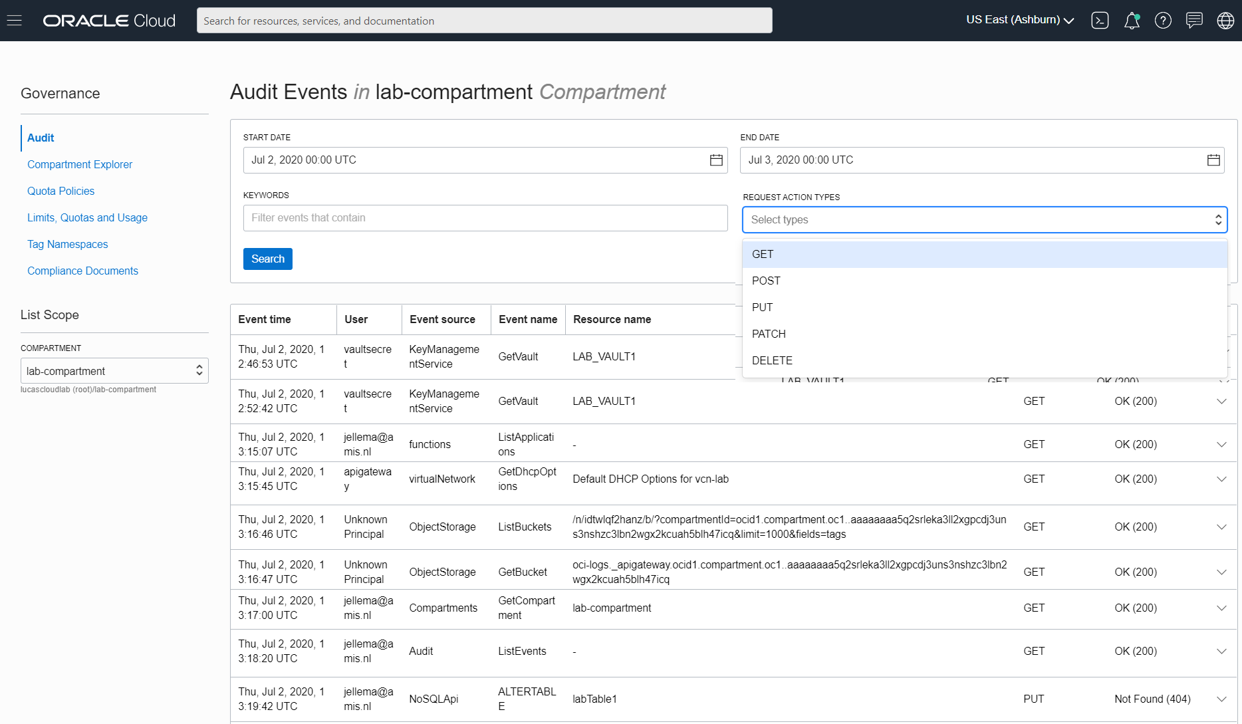

Slide 29
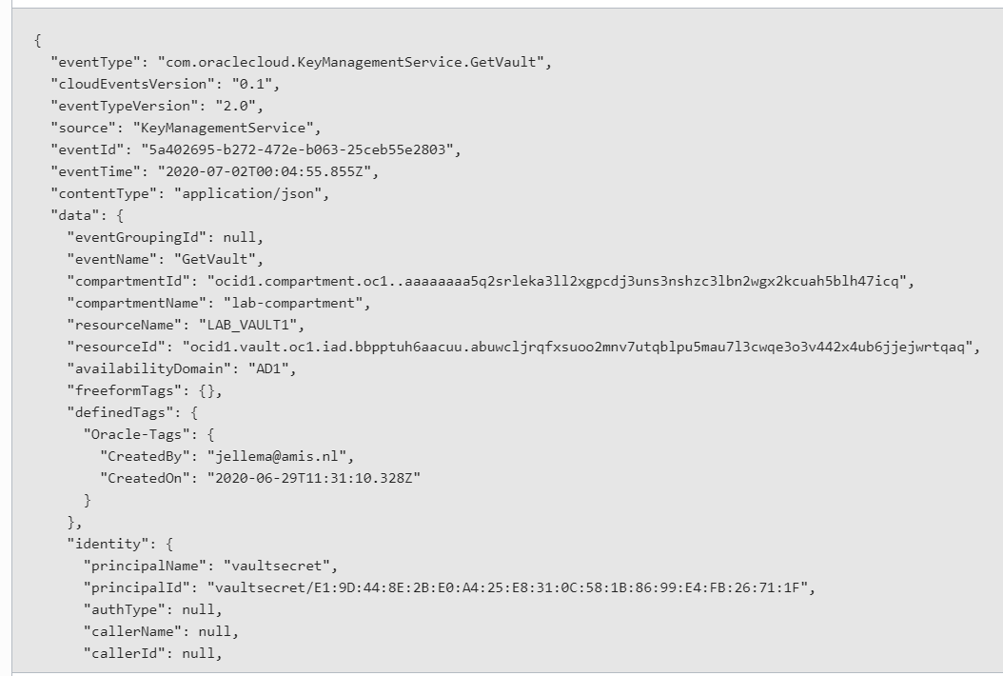
Audit Log Message

Slide 30


Why and What a Katacoda Scenario for Healthchecks Metrics Monitoring, Alarms and Notifications
In order to ensure successful operation of cloud native applications – production, collection and analysis of metrics is needed (technical as well as custom functional metrics)
Automated interpretation of critical metrics resulting in automated notifications and/or actions is desired
Check health of endpoints and resources – to make sure they can handle real workloads – from real user’s vantage point
Perform actions on OCI and collect corresponding metrics
Explore metrics
Define Alarm, have it publish to Notification Topic & send email
Raise alarm with exception activities
Publish, Explore, Alarm Custom (functional?) Metrics

Slide 31
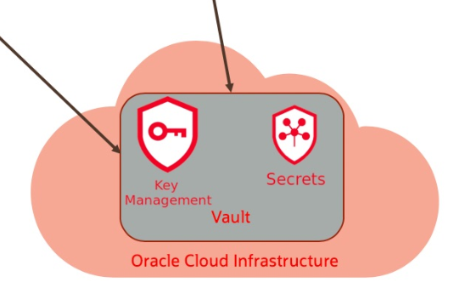

Slide 32
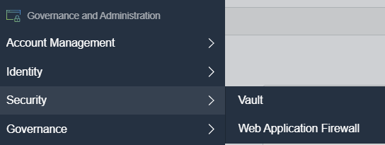
Vault – Manage Keys and Secrets
Vault
Imports or generates and manages Keys
Encrypts and Decrypts data using the Keys
Vault succeeds/includes OCI Key Management Service

Slide 33
Share Very Private Details in quite Public Way
Hand over (in insecure way)
Decrypted, readable text is available in component that has access to OCI Key API
Have Vault decrypt very private details (and make great is of them)
Very Private Details
Encrypt using Key

Slide 34
Share Very Private Details in quite Public Way
Hand over (in insecure way)
Decrypted, readable text is available in component that has access to OCI Key API
Have Vault decrypt very private details (and make great is of them)
Very Private Details

Slide 35
Vault – Manage Keys and Secrets
Vault
Imports or generates and manages Keys
Encrypts and Decrypts data using the Keys
Vault succeeds/includes OCI Key Management Service
Secrets
Secrets can be credentials such as passwords, certificates, SSH keys, or authentication tokens for third-party cloud services that you use with Oracle Cloud Infrastructure services
Or anything that you want safely stored and accessible in a central location
Secret management includes expiry date, version control, access management

Slide 36
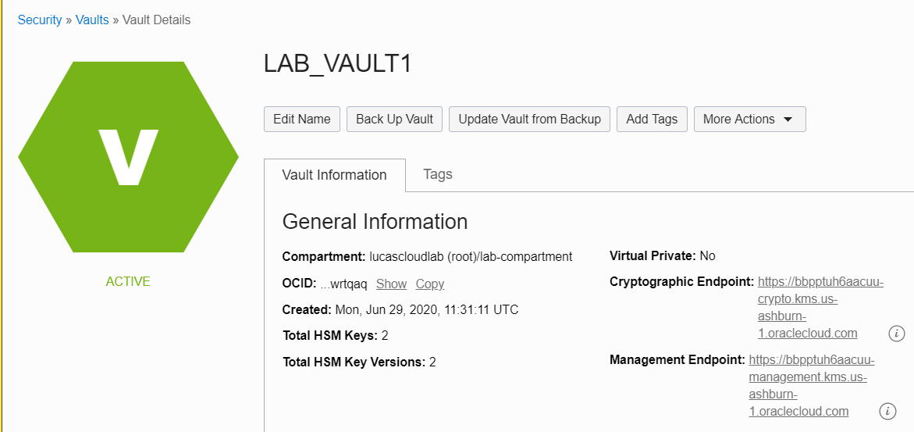
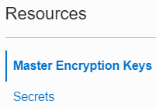
Vault
Vault can be default (free) or virtual private
A virtual private vault ($$$) is an isolated partition on a hardware security module (HSM) that ensures the security and integrity of the encryption keys and secrets that are stored in the vault.
Default Vaults share partitions on the HSM with other vaults.

Slide 37

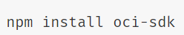
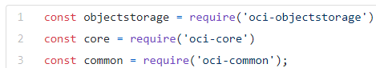
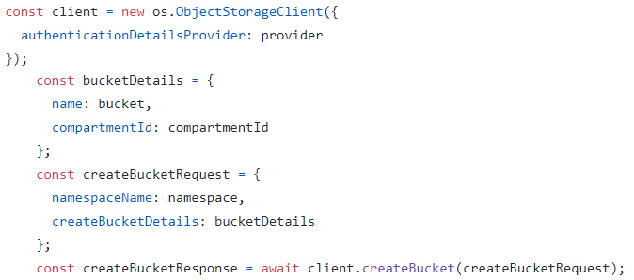
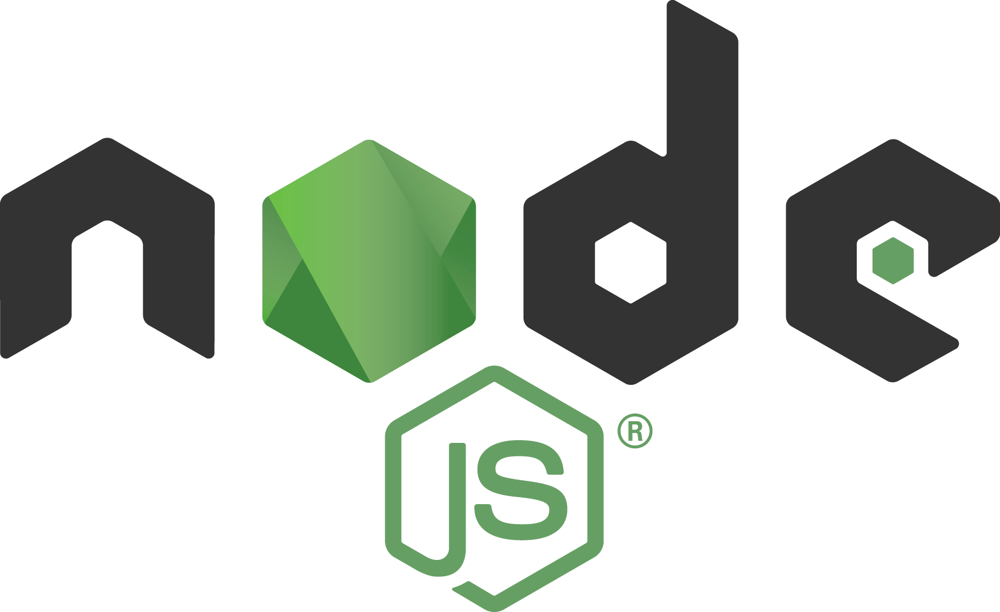


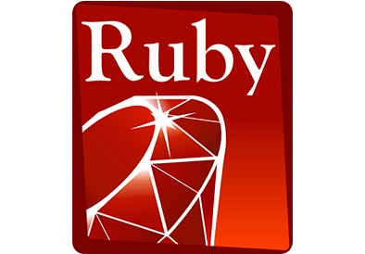


OCI SDK for TypeScript | JavaScript | Node
Open source NPM module oci-sdk
Source on GitHub
Require the libraries needed
Configure AuthenticationProvider
Create Service Client and Invoke operations
Resource
Virtual Machine
Resource
Buckets
Database System
Resource
Compute
Object Storage
DBaaS
Vault
OCI REST APIs
API/Service
OCI CLI
SDK
Terraform Provider
Notes:
https://github.com/oracle/oci-typescript-sdk
https://www.npmjs.com/package/oci-sdk

Slide 38
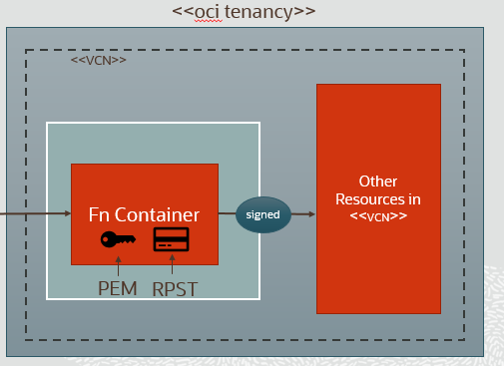
Resource Principal
Dynamic Group
Policy
Rule
Define a Dynamic Group
Define Rules to select Resources that are to be included in the group
Define Policies to grant privileges to members of the group
When a Function is in a Dynamic Group, it inherits the privileges and becomes “Resource Principal enabled”
a series of environment variables is available from within the RP enabled function:
OCI_RESOURCE_PRINCIPAL_RPST: the path to a file containing the Remote Principal Session Token (RPST) - formatted as a JWT and with claims that identify the tenancy and compartment that the function resides within
OCI_RESOURCE_PRINCIPAL_PRIVATE_PEM : the path to a private key that we'll also use to sign our request
Notes:
When RP auth is enabled for a function, there will be a series of environment variables available from within the function. We're concerned with two of those variables to help us sign our request, the first of which is OCI_RESOURCE_PRINCIPAL_RPST which contains the path on the machine to a file containing the Remote Principal Session Token (RPST). This is token is formatted as a JWT and contains claims that identify the tenancy and compartment that the function resides within. We'll ultimately parse the RPST to retrieve those claims and use the RPST to sign the request later on, but for now, just read the token into a variable
OCI_RESOURCE_PRINCIPAL_PRIVATE_PEM and it contains the path to a private key that we'll also use to sign our request
https://blogs.oracle.com/developers/resource-principal-auth-with-nodejs-for-easy-oci-rest-api-access-from-your-oracle-functions

Slide 39
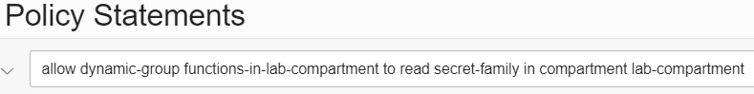
Function as Resource Principal that reads secrets within a compartment
Resource
Vault Secrets
Secret
OCI REST APIs
Policy
pem
rpst
Dynamic Group
Function
Rule

Slide 40
Why and What a Katacoda Scenario for Vault, Keys, Secrets and Resource Principal
Vault is a fairly new, widely usable service on OCI
Any application that requires strong encryption & decryption capabilities can benefit from Vault
Secrets are essential in all but the most trivial applications; Vault manages secrets in a convenient, safe manner
Credentials for databases and (3rd party) services can be safely managed outside code and configuration files
Create a Vault (of type Default)
Generate a Key and do some Encryption & Decryption
Store a Secret
Retrieve the Secret – through OCI CLI and from a Node app
Using the OCI SDK for TypeScript | Node | JavaScript
Create Resource Principal enabled Function that reads a secret

Slide 41
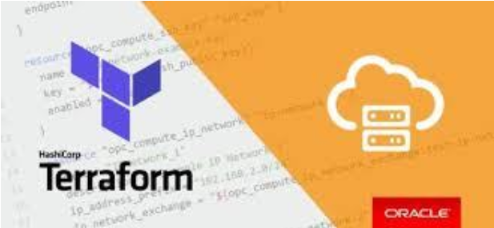
Automation – Infra as Code
Define the desired OCI Resources in one or more JSON files
Provide OCI configuration file
Have Terraform with OCI Provider process the declarative resource definitions
Verify if resource exists
if it does, make sure it is in the desired state
If it does not, create the resource as defined
Terraform can be ran in ‘plan mode’ which will report what it will do when for real
Terraform can destroy everything it is told to manage (undo the plan execution)

Slide 42
Infra as Code
Resource definitions
Tool (editor, generator) Support
Reuse (modules/libraries)
Version Control (compare/merge)
Declarative language for describing resources in a structured way (evolving along with the resources supported by the platform)

Slide 43
Infra as Code
Cloud Resources
Resource definitions
“engine”
Variables/Config Settings
Tool (editor, generator) Support
Reuse (modules/libraries)
Version Control (compare/merge)
Declarative language for describing resources in a structured way (evolving along with the resources supported by the platform)
No manual changes
Automated (triggered, executed)
Fairly quick
Consistent (once correct, always correct)
Plus:
Detect Drift
Patch existing resources
Recover/fail over failed resource

Slide 44
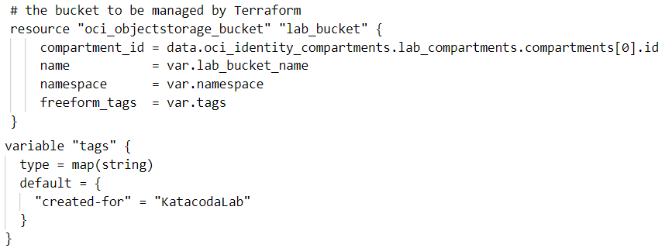
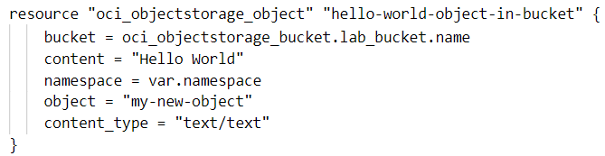
Infra as Code: Terraform on OCI
Oracle Cloud Infrastructure Resources
Resource definitions
Terraform plus OCI Provider
44444
Environment Variables
Namespace, Compartment Id, Bucket Name
Variables/Config Settings
Buckets
OCI config and Private Key
Run in Plan, Apply and Destroy mode

Slide 45
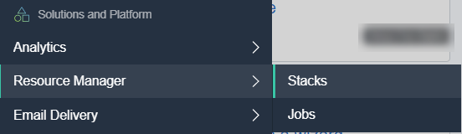
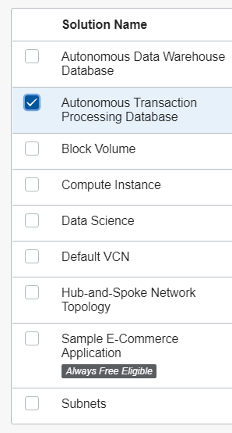
OCI Resource Manager, Stacks and Jobs
Stacks are Terraform configurations
Uploaded to OCI
Custom Stacks (user defined) and Sample Solution Stacks (Oracle defined)
Such as Autonomous Database, Compute Instance, …
Stacks can easily be edited, exported, shared, …
Use schema.yaml to define variable details – conditions, defaults, LOVs
A Stack is configured – all its input variables are set
Jobs can be ran on a Stack: to plan, apply and destroy
Jobs retain logs of Terraform activity
Resource Manager manages stacks and jobs
Support for Remote Exec(ute) to execute script(s) on a remote host such as on a VM that has been provisioned

Slide 46
Why and What a Katacoda Scenario for Automation: Infra as Code – Terraform Provider & Resource Manager
Automation is a crucial part of cloud native applications and of true agile DevOps
We want to treat both applications and platform/infra resources in the same code centric way (development, versioning, pipelines)
OCI Resources can be created and synchronized from declarative code based descriptions: Terraform templates
Prepare a Terraform environment with OCI provider and configuration for your OCI Tenancy
Create a simple Terraform configuration and use it to create, manage and finally destroy resources
Use Terraform to create and invoke a Function
Get introduced to OCI Resource Manager, Jobs and Stacks

Slide 47

Q&A and Live Handson
Ask your questions in the Zoom Q&A Window
Get your Cloud Trial:
We will stay online for the next hour to help you out with handson challenges
cloud.oracle.com/tryit
http://bit.ly/real-oci
Recordings are on YouTube: bit.ly/real-utube

Slide 48
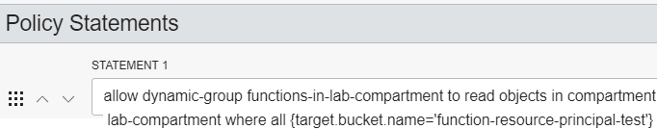
Resource
Object Storage
Buckets
OCI REST APIs
Policy
pem
rpst
Dynamic Group
Function
Rule

